Slide 1

TRAVEL AGENCY DATA PLATFORM PROJECT ZAINAB OJO

Slide 2
PROJECT OVERVIEW
This project involves developing a Data Platform for a travel agency to process data from the Country REST API into a cloud-based database/data warehouse. The platform is designed to enable the agency's Data Science team to perform predictive analytics, providing actionable insights to recommend tourist destinations based on various data points.

Slide 3
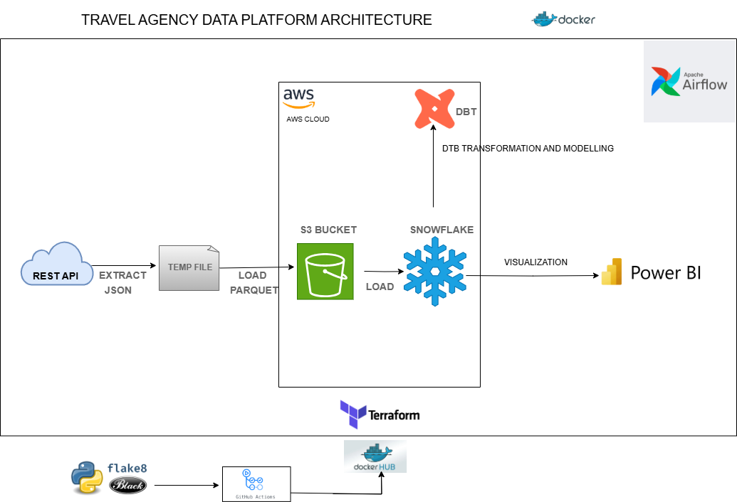
DATA ARCHITECTURE

Slide 4

TOOLS AND TECHNOLOGIES
Apache Airflow: Orchestration of data flow.
Terraform: Infrastructure provisioning (IAM, Object Storage, etc.).
DBT: Data modeling (Fact and Dimension tables).
S3 Storage: Storing raw data in Parquet format.
Snowflake: Cloud-based data warehousing.
Power BI/Tableau: Data visualization for insights.
Docker: Containerization for CI/CD.
CI/CD Pipeline: Continuous Integration and Deployment for project automation

Slide 5
INFRASTRUCTURE PROVISIONING
Leveraged Infrastructure as Code (IaC) using Terraform to efficiently provision and manage resources.
Key resources provisioned:
S3 Bucket: For storing raw data and Terraform state files.
IAM Roles and Policies: To securely grant permissions for accessing and managing resources.
Terraform State Management: Configured to store the Terraform state file in the S3 bucket, ensuring centralized and secure state tracking.

Slide 6
DATA PIPELINE ORCHESTRATION USING AIRFLOW
Extract Data
Fetch raw data from the Country REST API using Airflow's task scheduler.
Store Data
Save the extracted raw data in Parquet format for efficient storage and performance.
Upload the Parquet files into an S3 Bucket, forming the raw data layer.
Transform & Load Data
Extract required attributes (e.g., region, population, languages) from the raw data in S3.
Load the transformed data into Snowflake, a cloud-based data warehouse, for downstream analytics.
Orchestration
Airflow automates the entire workflow:
Extraction from the API.
Staging raw data in the data lake (S3).
Transformation & Loading into Snowflake.
Ensures robust and error-monitored pipelines.
Using Apache Airflow to orchestrate the entire pipeline

Slide 7
Data Loading
The cleaned data was loaded into Snowflake from the S3 bucket.
Snowflake serves as the central data warehouse, storing structured data for transformation and analytics.
Transformation Process Using DBT
DBT (Data Build Tool) was used to transform the raw Snowflake data into an analytics-ready format.
Models were created to structure the data into Fact and Dimension tables.
Modeling Approach
Fact Table:
Fact_Countries: Contains aggregated and measurable data such as total population, area, and population density.
Data Transformation & Modeling (DBT)

Slide 8
Dimension Tables:
Dim_Currency: Details of currency in each country.
Dim_Countries Region-specific details like continent and subregion.
Additional dimensions include information about currencies, capitals, and other descriptive attributes.
Data Transformation & Modeling (DBT) CONT.

Slide 9

CI/CD Implementation for GitHub Repository
Continuous Integration (CI):
Automated checks were implemented to ensure high-quality code.
Code Linting:
Integrated linting tools into the CI pipeline to enforce coding best practices and standards.
Detected and resolved code issues early in the development cycle, ensuring maintainable and clean code

Slide 10
CONTAINERIZATION
Continuous Deployment (CD):
Configured the CD pipeline to automate build and deployment tasks.
Build and Push Process:
Packaged the ETL code into a Docker image for portability and scalability.
Pushed the Docker image to a cloud-based container registry (e.g., Docker Hub) for deployment.
Simplified deployment to ensure the ETL process is consistent across environments.

Slide 11
INSIGHTS DERIVED FROM THE DATA
Population Density Map:
Highlights global population distribution patterns, revealing densely populated regions such as South Asia and Europe, and sparsely populated areas like deserts and arctic zones.
These insights offer opportunities for sustainable development, resource allocation, and identifying potential markets for growth.
Global Influence of English:
English emerges as a globally significant language, appearing in all six regions within the dataset.
While it is not the most spoken language everywhere, its widespread adoption underscores its role as a universal bridge for communication and commerce.

Slide 12
INSIGHTS DERIVED FROM THE DATA CONTD.
Population by Region:
The "Total Population by Region" chart underscores regional population distribution, with Asia dominating at 59.2% of the global total.
This statistic emphasizes Asia's prominence in global demographics and its potential as a focal point for global strategies.
Top 10 Countries by Population:
The "Top 10 Countries by Population" visual highlights the world's most populous nations, with China leading as the largest.
These countries represent key areas for addressing large-scale population needs and opportunities.
Language Reach by Population:
The "Language Reach by Population" chart identifies English as the most widely spoken language globally in terms of population reach.
Its extensive use spans multiple continents, serving as both a primary and secondary language, reinforcing its pivotal role in global communication.

Slide 13



Global Travel Analytics Dashboard
View in Power BI
Last data refresh:
11/22/2024 2:25:02 PM UTC
Downloaded at:
11/22/2024 2:33:42 PM UTC

Slide 14
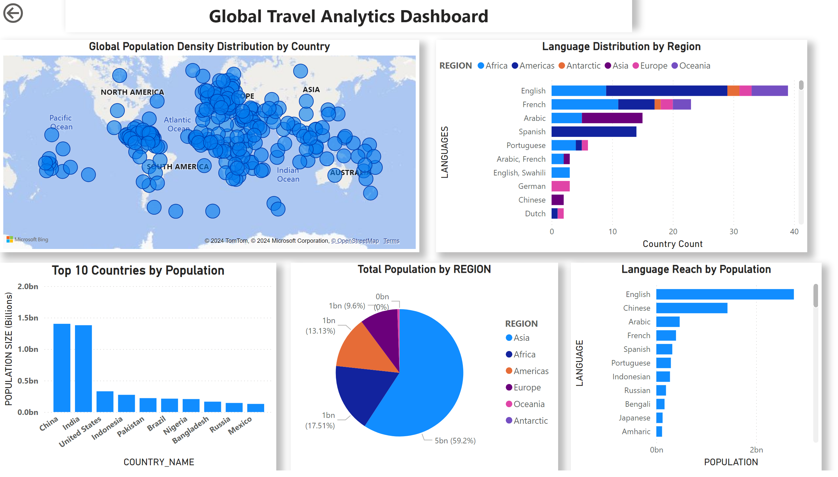
Page 1
Notes:
Global Population Density Distribution by Country
No alt text provided
Top 10 Countries by Population
No alt text provided
Language Distribution by Region
No alt text provided
pieChart
No alt text provided
actionButton
No alt text provided
Language Reach by Population
No alt text provided
textbox
No alt text provided

Slide 15

CONCLUSION
This project exemplifies the development of a robust data platform using modern data engineering practices. By leveraging cloud-based tools, efficient orchestration frameworks, and data modeling techniques, it simplifies complex workflows and delivers actionable insights. These insights empower businesses, such as the travel agency, to make data-driven decisions and unlock new opportunities for growth and innovation.

Slide 16

Thank you

